Slide 1

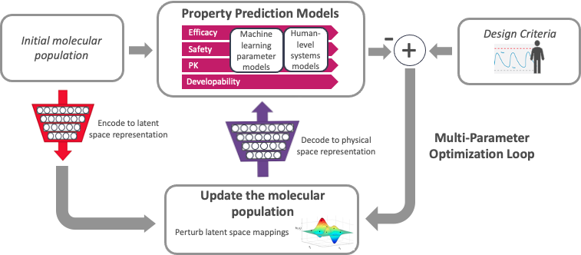
Titli Sarkar
ATOM Team
BIDS SDSI
Accelerating Therapeutics for Opportunities in Medicine (Cancer Research)
ATOM Pipeline
Shared Space
Availability (Github)
Model and Data Clearinghouse (MoDaC)
Molecular data library - Open curated and model-ready database
2. AMPL
AMPL Tutorial
Publicly available curated dataset
AMPL Predictive Models
Distributed collaborative public facing API
Data Management/Transfer
Configurable access levels
Transferability
3. GMD
GMD Pipeline
AI and computing-driven molecular discovery and optimization
AMPL Pipeline
GMD Pilot Project –
Neurocrine H1 Design
Data Ingestion + Curation
Model Training + Tuning
Featurization
Prediction Generation
Visualization + Analysis
3. GMD - A high-performance platform for parallel optimization of efficacy, safety, and pharmacokinetics
Data Lake
Model Zoo
Results DB
Example – GMD Pilot design projects in cancer, infectious disease and other areas;
H1 histamine receptor pKi > 9
M2 muscarinic receptor pKi < 6
2. AMPL (ATOM Modeling PlpeLine) –
Predictive modeling: training, optimization, and property prediction
atomscience.org | @ATOM_consortium | #ATOMscience

